Slide 1
Can The Robots Save You?
The Intersection of Artificial Intelligence and Information Security
Bryce Turner
10/13/2018
Big Mountain Data and Dev Conference

Slide 2











Thanks to our Sponsors!
Partners
Premier
Logo:

Slide 3
Roadmap
Introduction to Infosec
Breach Case Studies
AI in Infosec
Infosec in AI
Conclusions

Slide 4


About Me
Infosec consultant by day
Pen testing
Log monitoring
Risk assessment
CS (machine learning) student by night

Slide 5
Introduction to Infosec

Slide 6
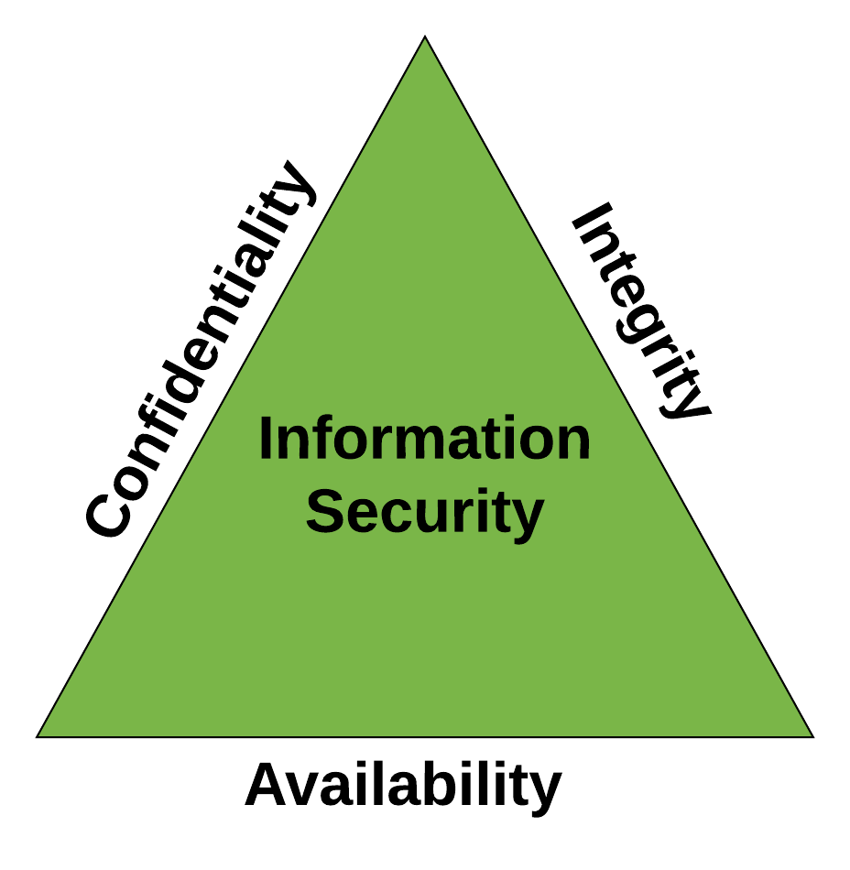
Information Security – The Triad
Confidentiality
Data is not available to unauthorized individuals
Integrity
Data is accurate and not modified unnecessarily
Availability
Data is available when needed

Slide 7
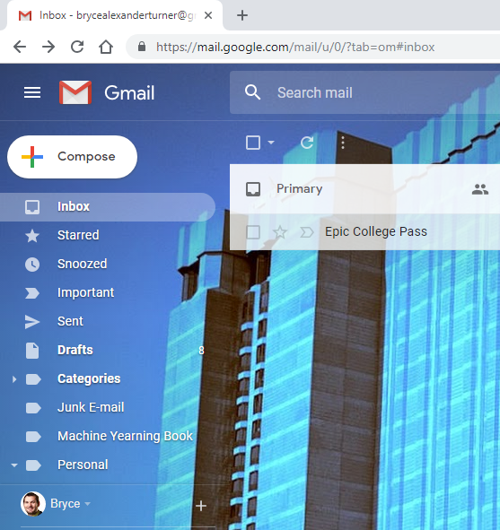
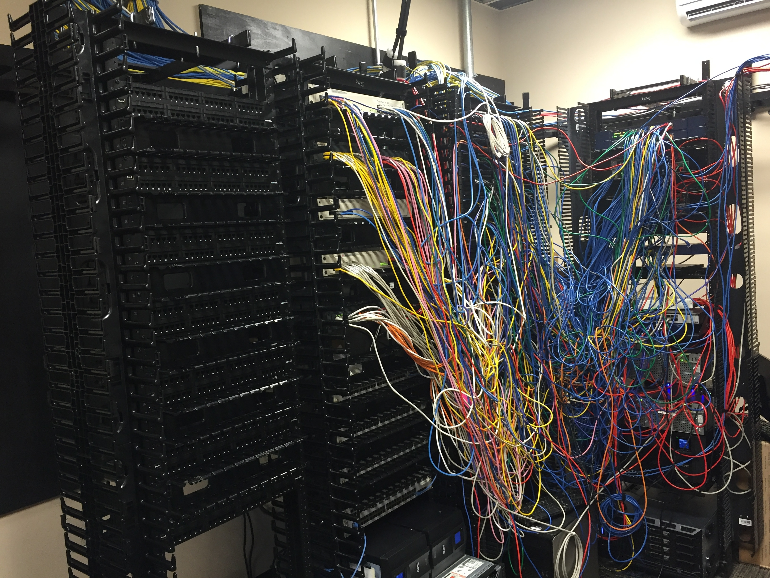

Information Security: What Are We Protecting?
Applications
Web applications
Mobile applications
Network
External/internal
Physical Assets
Cash, servers, etc
Intangibles
Brand & reputation

Slide 8
How Do We Protect These?
Blue team
Maintain network integrity, detection
SOC, IDS, Hardening
Red team
Penetration testing
Social engineering testing
Risk management
Risk assessment
Strategic planning

Slide 9
Breach Case Studies

Slide 10
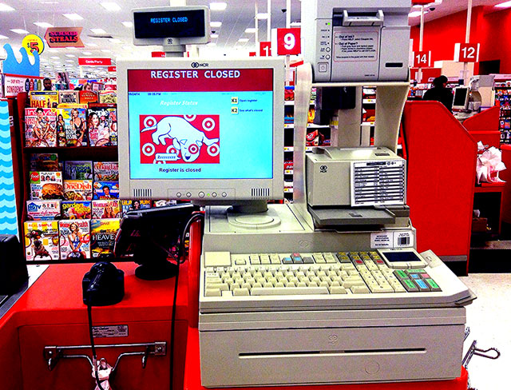
Target Breach (2013) – Likely Steps
OSINT to identify vendors
Including details of POS systems!
Social engineering of vendor (using malware)
Gain vendor level access to Target network
Get domain admin access on unpatched domain controller
Distribute malware to POS systems from DC
Skim card data via ICMP traffic on network
Breach identified due to strange FTP traffic to external address
Radichel, Teri Case Study: Critical Controls that Could Have Prevented Target Breach SANS Case Studies. September 2014

Slide 11
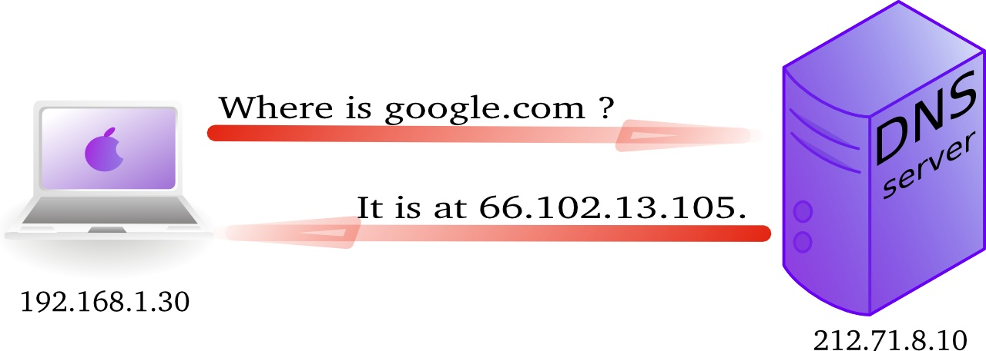
DYN DDOS (2016) – Likely Steps
Mirai malware published online
Targets IOT devices
Some group (or possibly individual) obtains code
Distributes code to a botnet
Mirai botnet contained roughly 100,000 nodes
Botnet makes DNS queries to Dyn
Recursive queries amplifies attacks
Approaches 1 Tbps

Slide 12

Equifax Breach (2017) – Likely Steps
Attackers discover portal with unpatched vulnerability
Likely months old
Initial recon occurred within two days
Exploit vulnerability and gain internal access
Pivot to internal database
Exfiltrate data over months
Use encrypted channels and segmentation
Misconfiguration allowed for encrypted traffic to be uninspected
Detection immediately following proper configuration
Marinos, Nick & Clements, Michael Actions Taken by Equifax and Federal Agencies in Response to 2017 Breach USGAO Report to Congressional Requesters. August 2018

Slide 13
Features of Breaches
Often involve phishing
Pivoting from initial entry point
Slow detection time (average attacker on network for months)
Poor strategy (unpatched systems, bad vendor management)
Breach Involved | 2008 | 2018
External Actor | 73% | 73%
Internal Actor | 18% | 28%
Malware | 31% | 30%
Business Partner | 39% | 2%
DOS | Unreported | 71%
Verizon Data Breach Report 2008 & 2018

Slide 14
AI in Infosec

Slide 15
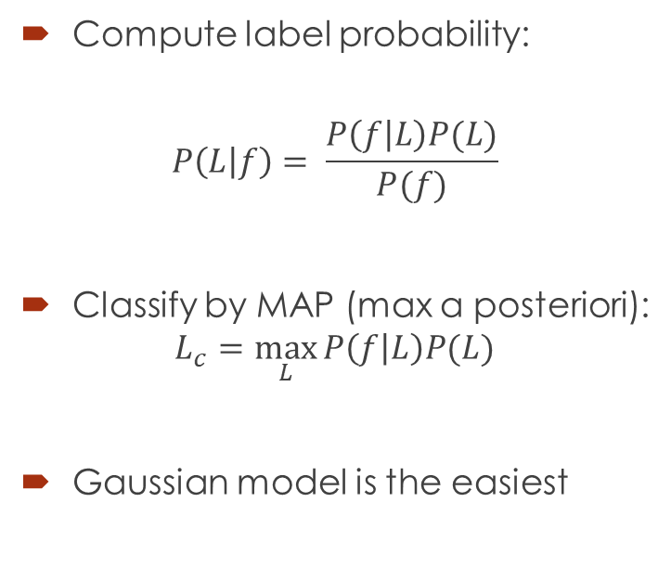
Naïve Bayes Introduction
Compute label probability:
$$P\left(L | f\right)= \frac{P\left(f | L\right)P(L)}{P(f)}$$
Classify by MAP (max a posteriori):
$$L_{c}=\max_{L}{P\left(f | L\right)P(L)}$$
Gaussian model is the easiest

Slide 16
Spam Detection With Naïve Bayes
Dataset has 4601 (1813 spam) instances with 57 attributes
Use text classification (bag of words) to identify spam
Scikit-learn implementation of Naïve Bayes classifiers
Method | Mislabeled Points | Mislabeled Percentage | False Positive | False Negative
Gaussian | 815 | 17.71% | 74 | 741
Multinomial | 955 | 20.76% | 505 | 450
Complement | 952 | 20.69% | 473 | 479
Bernoulli | 525 | 11.41% | 335 | 190

Slide 17
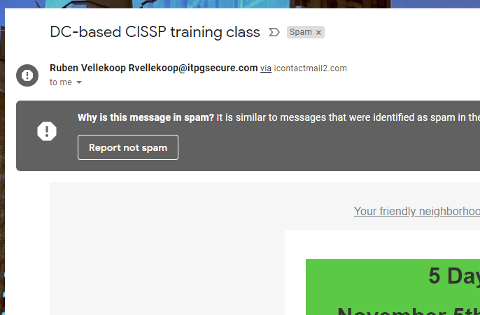
Naïve Bayes
Pros
Cons
Fast (especially if you have priors)
Effective for small training sets
Can be done iteratively
Harder to tune than other models
Often outperformed by other techniques (boosting, random forest)
Poor estimators

Slide 18
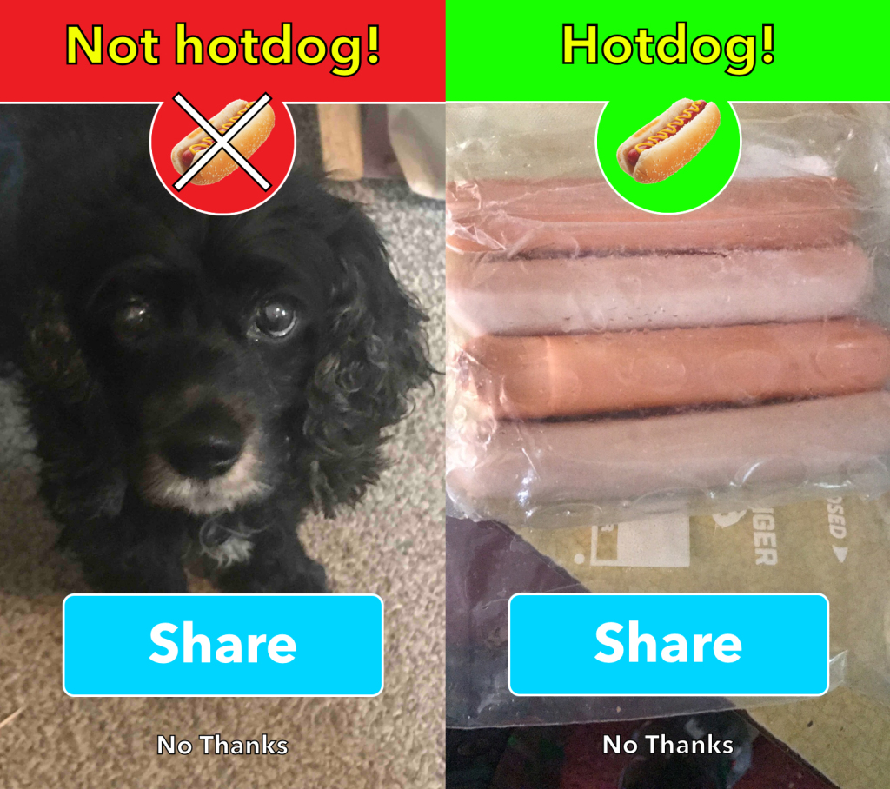
Supervised Learning for Phishing Sites
Labelled training data
30 attributes
2456 instances
Tested multiple classifiers with scikit-learn implementations
Boosting
Decision Trees
k-NN
Support Vector Machines
Classify test data
Iterate on certain techniques

Slide 19
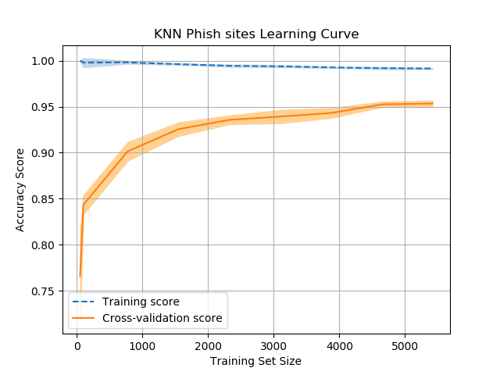
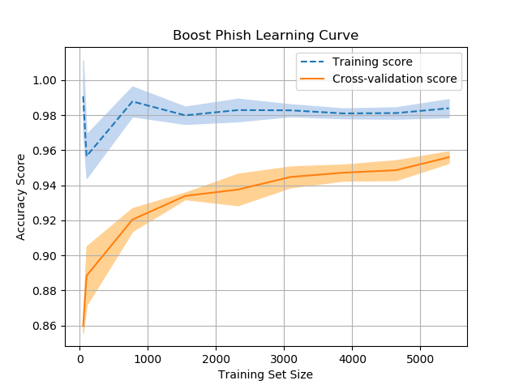
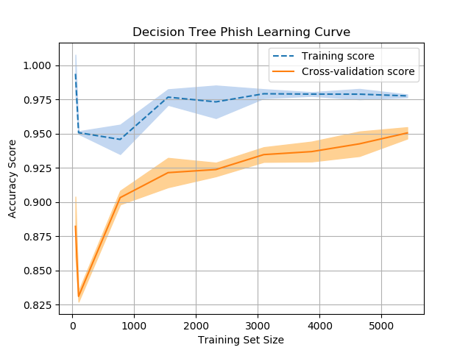
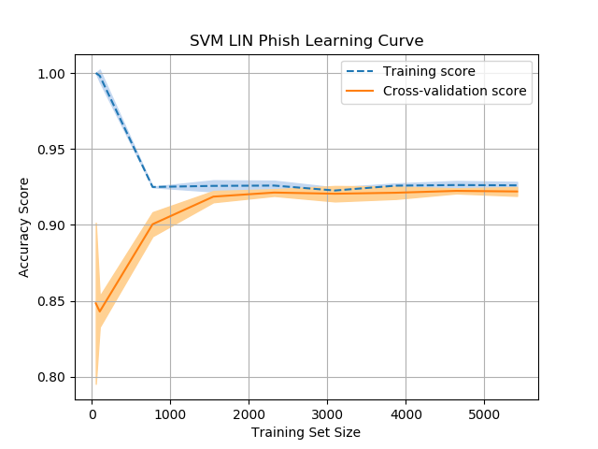
Results
Method | Training Time (ms) | Testing Time (ms)
Boosting | 165.99 | 6.29
Decision Trees | 18.90 | 2.37
K-NN | 2.04 | 481.69
SVM | 2.92 | 613.06

Slide 20
Supervised Learning Efficacy
Pros
Cons
Effective
>90% accuracy for most
Quick for most techniques
All but SVM under 1 sec each run
30 attributes
Hard to implement in real-time
Parameter tuning
Used GridSearch, feasible in live system?

Slide 21
So…. Can AI prevent breaches?

Slide 22
AI & Breaches
Breaches happen because:
Systems are unpatched
People are phished
Systems are configured improperly and don’t catch intrusions
AI is (currently) good at:
Classifying well-structured data
Finding anomalies (in well-structured data)
So maybe (if the system has well-structured data)

Slide 23
Infosec in AI

Slide 24

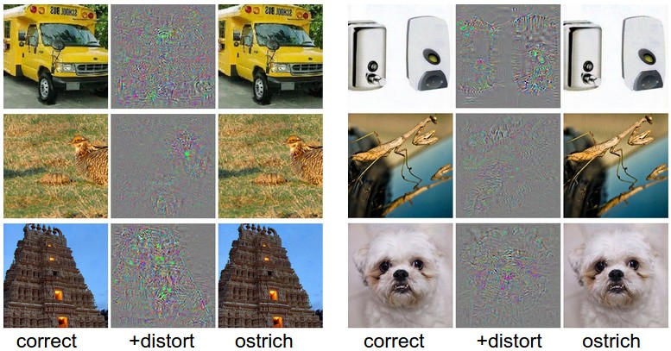
Attacking Machine Learning Models
Generate misclassifications in a model
Cleverhans (tensorflow) can test this
Low risk for some scenarios
Lost revenue for an hour is fine
Others….
Look at this enemy tank!

Slide 25
Conclusions

Slide 26
AI & Infosec
Infosec data is very heterogenous
AI is still learning how to deal with this
Intrusion detection relies on multiple systems
Fairly robust for phishing/social engineering
Infosec relies a lot on proper configurations
Misconfigured AI will miss things
Bad data is bad data
Hackers are lazy but smart
Unless they’re backed by the government

Slide 27
Future of AI and Infosec
AI will likely augment current processes
Better intrusion prevention
Compliment some offensive techniques
Hacking AI systems (GIGO) will become popular
Attacks on AI embedded systems (cars, SCADA, etc) will increase
Automated phishing techniques and DDOS

Slide 28
Thank you!
https://github.com/jamison-alexander/datamountaindev2018
Email: tbryce88@gmail.com

